Slide 1
2017 Nevada School Garden Program
Methods of Watering in Hoop-houses
Soil + Crop Covers for Hoop-houses
Presented by
Ray Johnson
Custom Gardens Organic Farm
Silver Springs, Nevada 89429
customgardens@att.net
775-577-2069

Slide 2
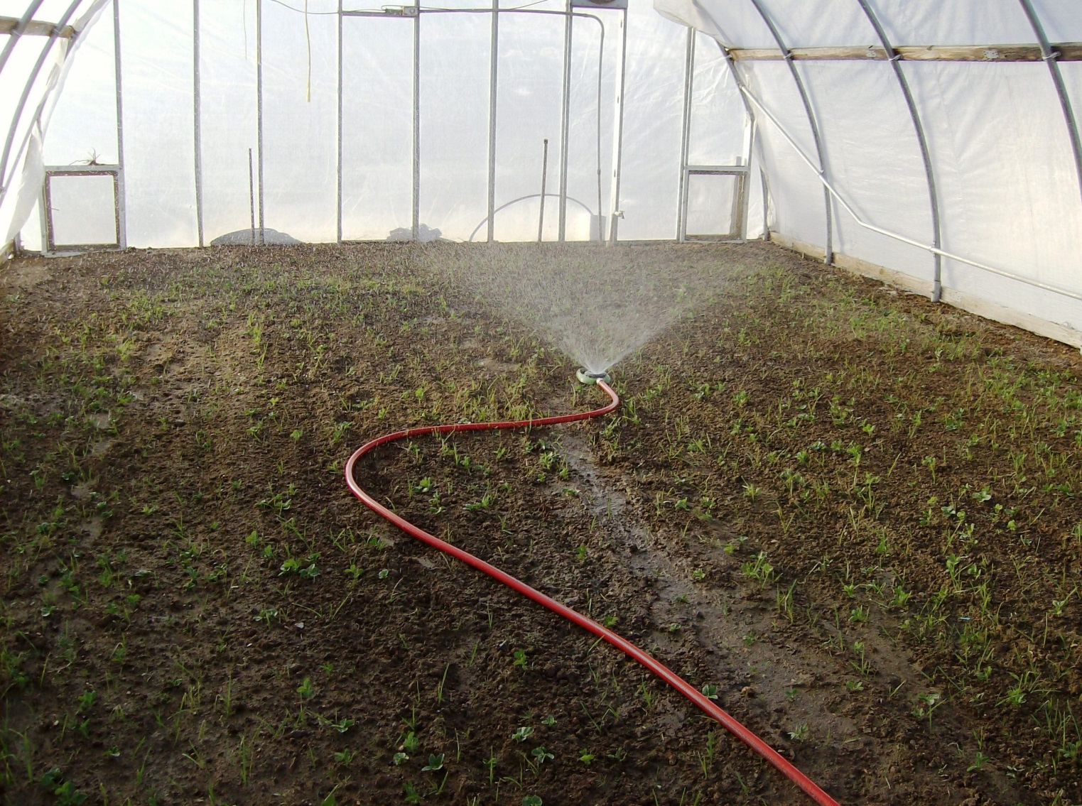
What are you growing?
SHOWING
OVERWINTERING
GREEN MANURE
COVER CROP
TO BE TILLED IN …

Slide 3
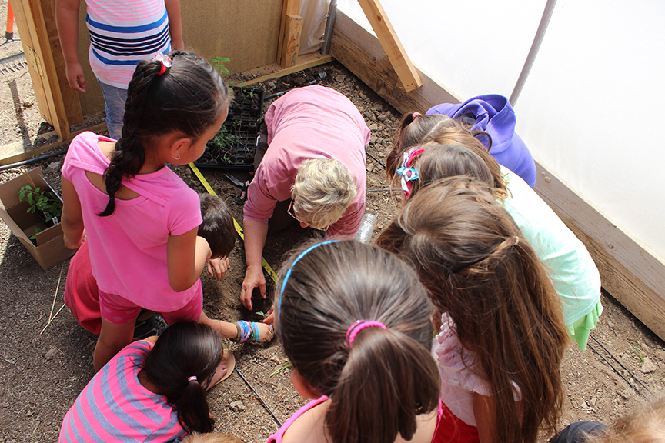
YERINGTON ELEMENTARY SCHOOL
In 2015, one school in Yerington harvested 524 LB of produce from their school garden / 14X24’ hoop-house. This is serious. One seed, one tiny plant at a time!

Slide 4
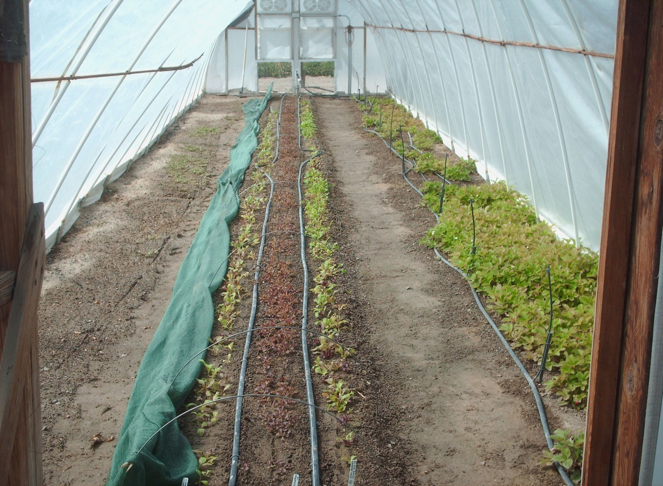
HOOP 1 – ORIGINAL HOOPHOUSE AT CUSTOM GARDENS ORGANIC FARM
Early summertime view – note shade available to cover lettuce.

Slide 5
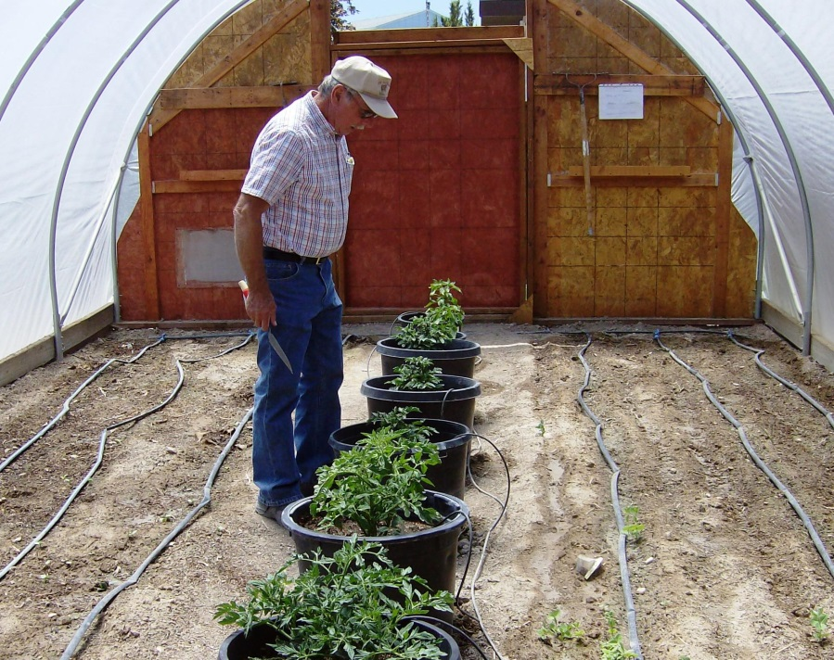
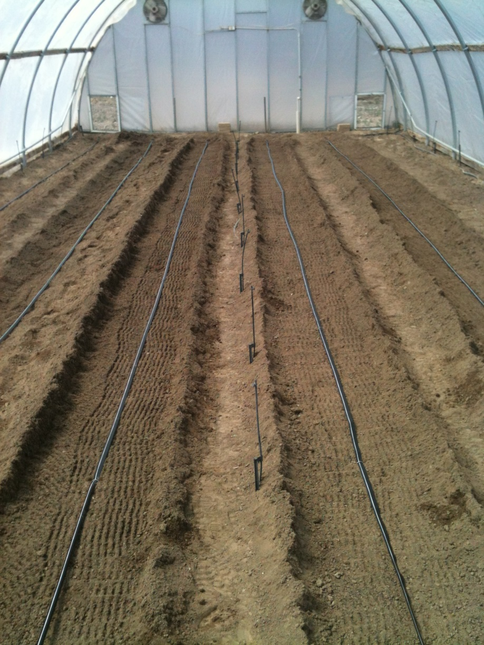
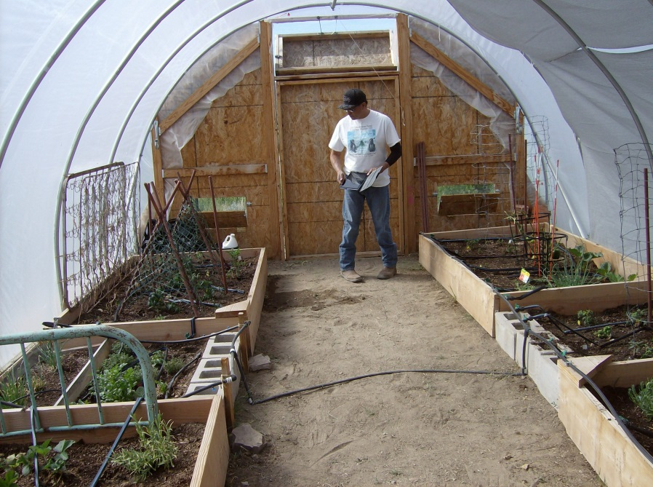
ELY NV.
INDIAN
COLONY
Hoop 5: Custom Gardens
YAMBA
INDIAN
RESERVATION

Slide 6
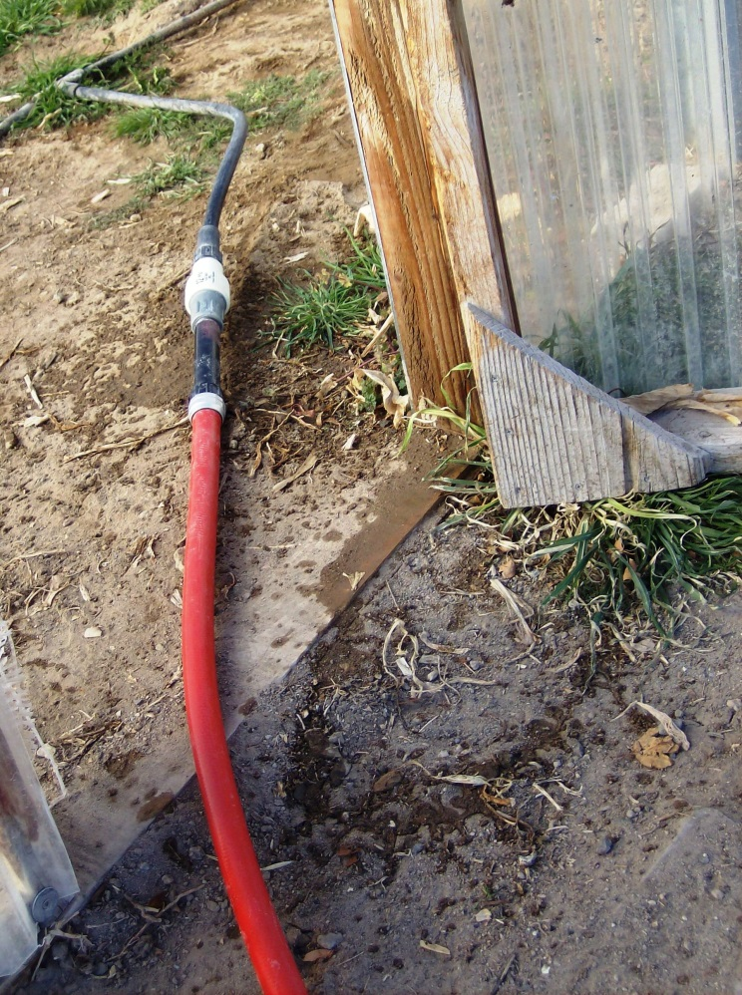
What’s your water source?
NOT VERY EFFICIENT
if you are having to wait on
ice & frozen hoses
OR
Will be dragging a hose over your plants

Slide 7
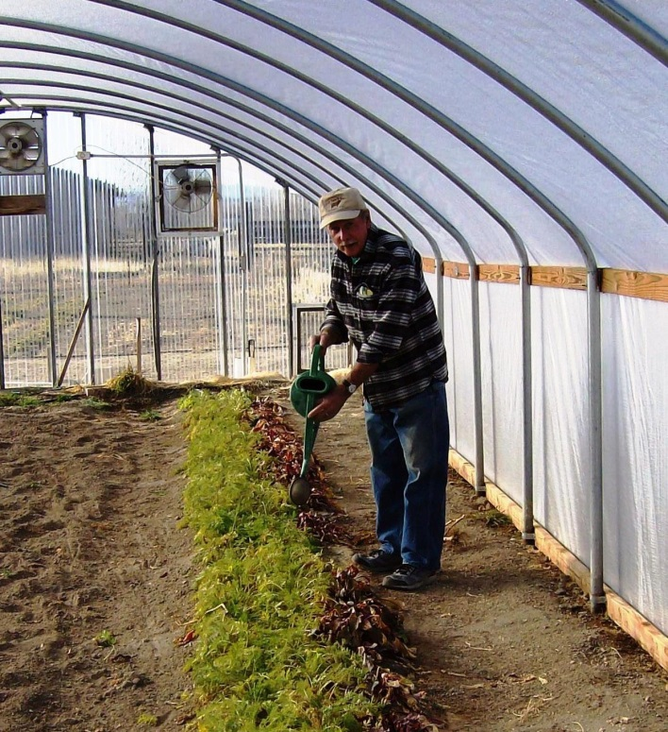
For my 40 ft bed-rows, I filled up 5 x
Watering by hand

Slide 8
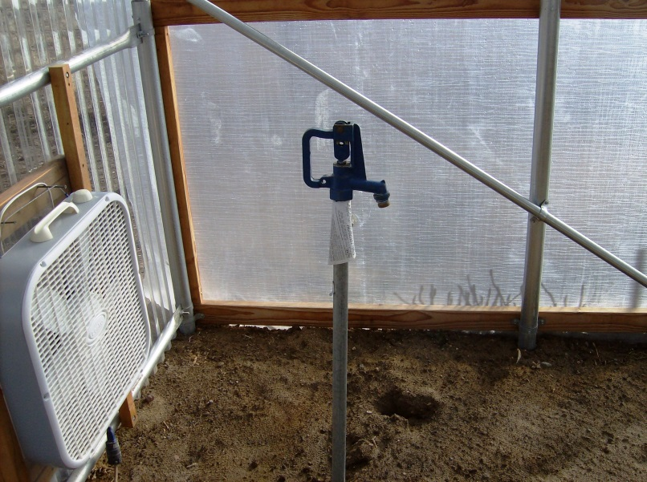
Preferred method – a freezeless faucet inside your hoop house.

Slide 9
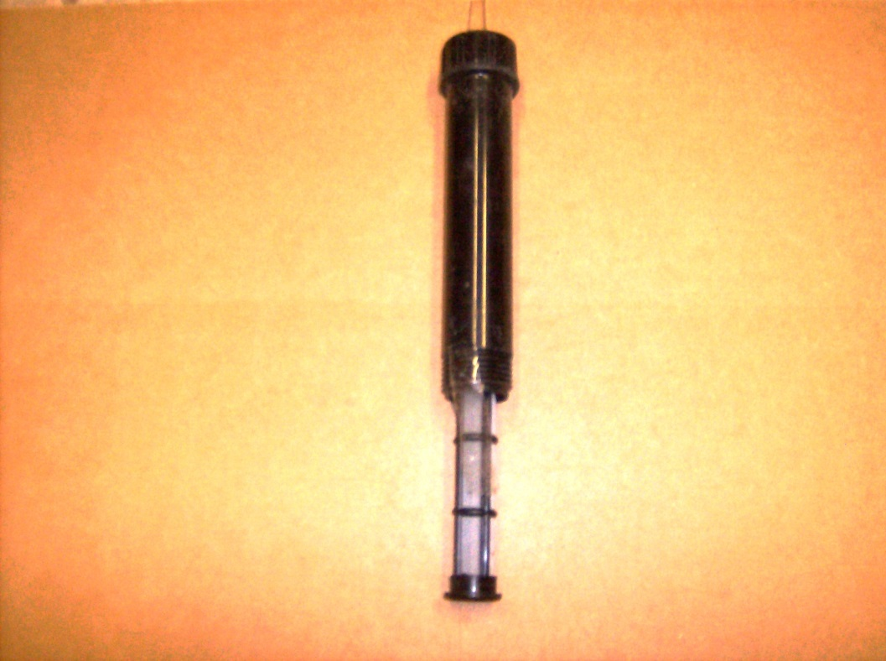
Putting it all together
LINE FILTER

Slide 10
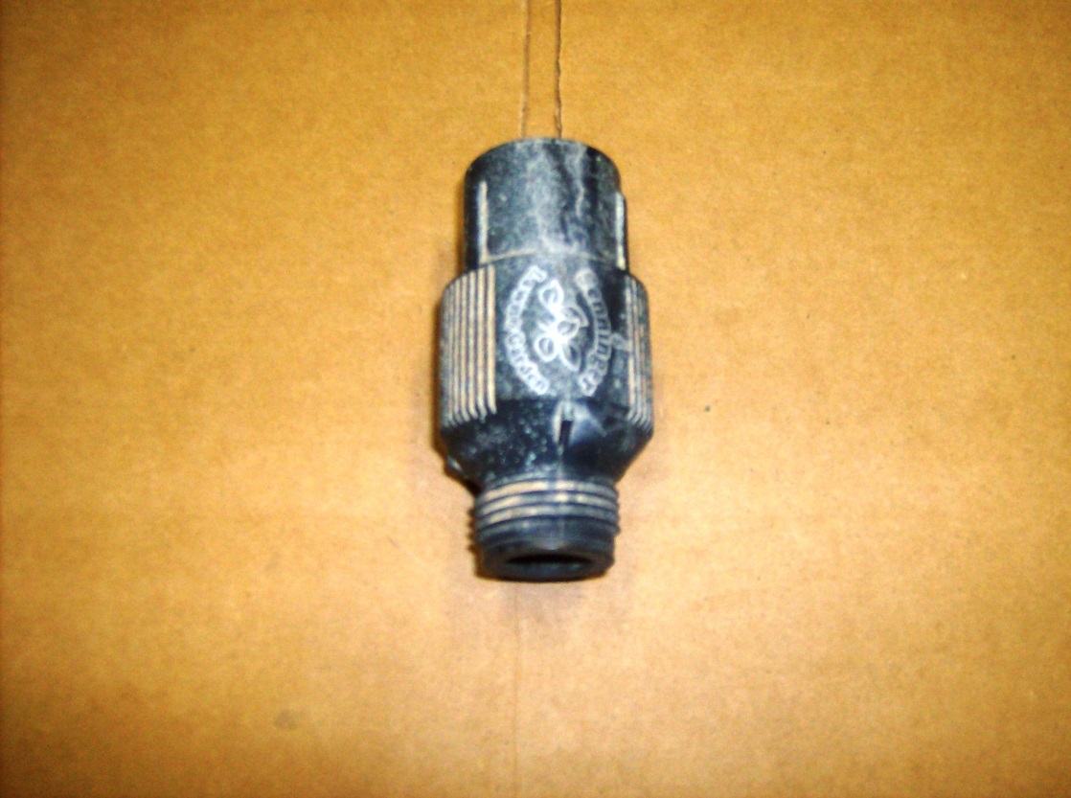
PRESSURE REGULATOR

Slide 11
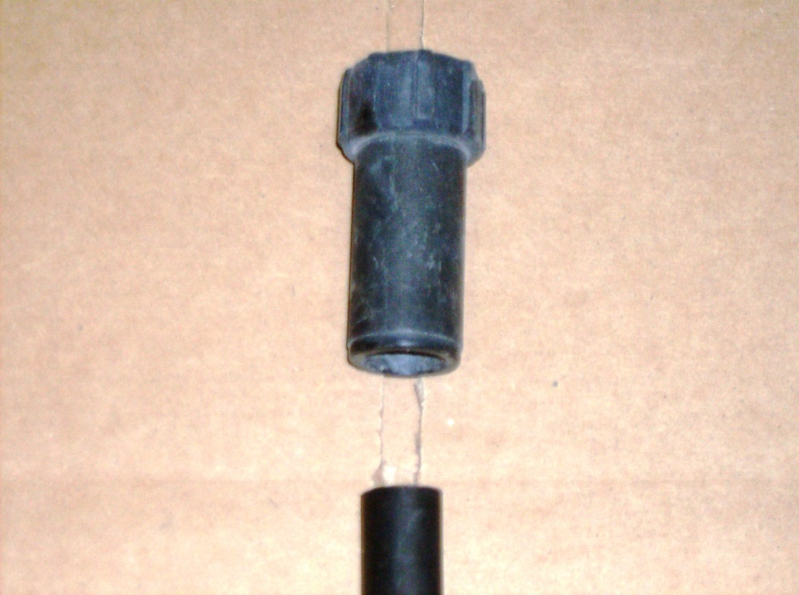
FEMAIL HOSE CONNECTOR

Slide 12
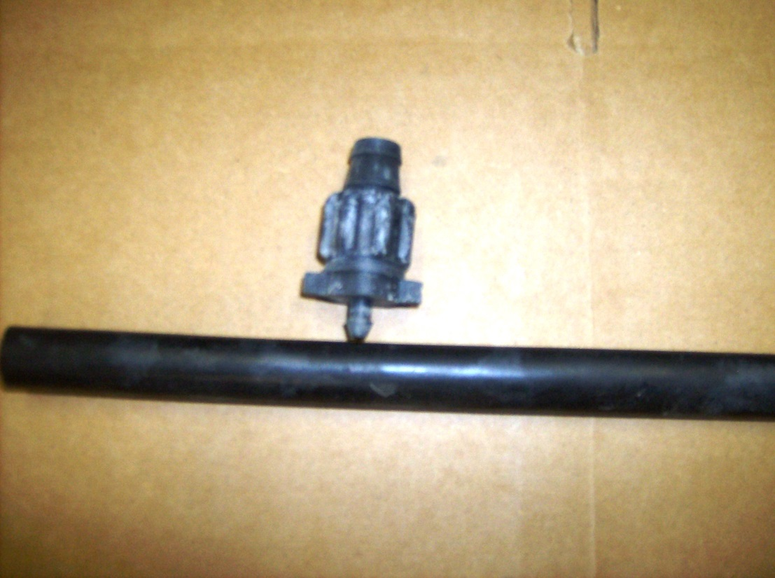
T-TAPE CONNECTOR

Slide 13
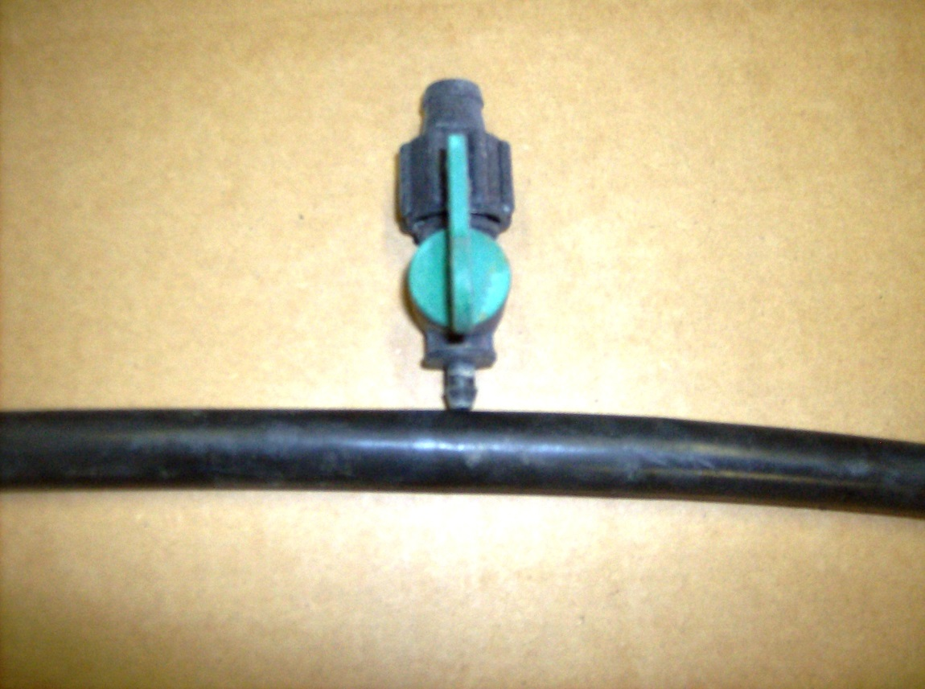
T-TAPE CONNECTOR
WITH
SHUT OFF VALVE
MAIN LINE

Slide 14
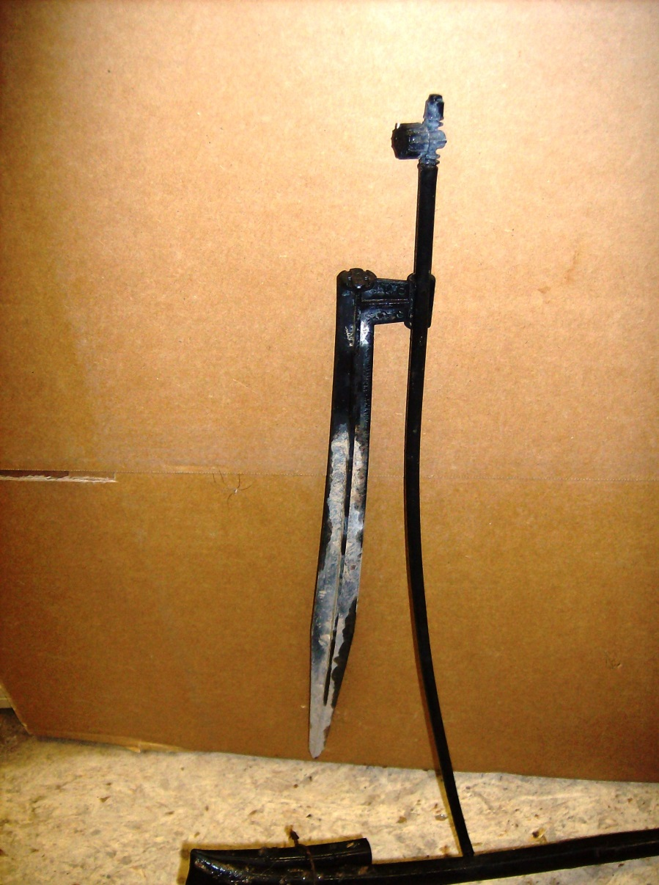
SPRAYER
WITH
RISER
AND STAKE

Slide 15
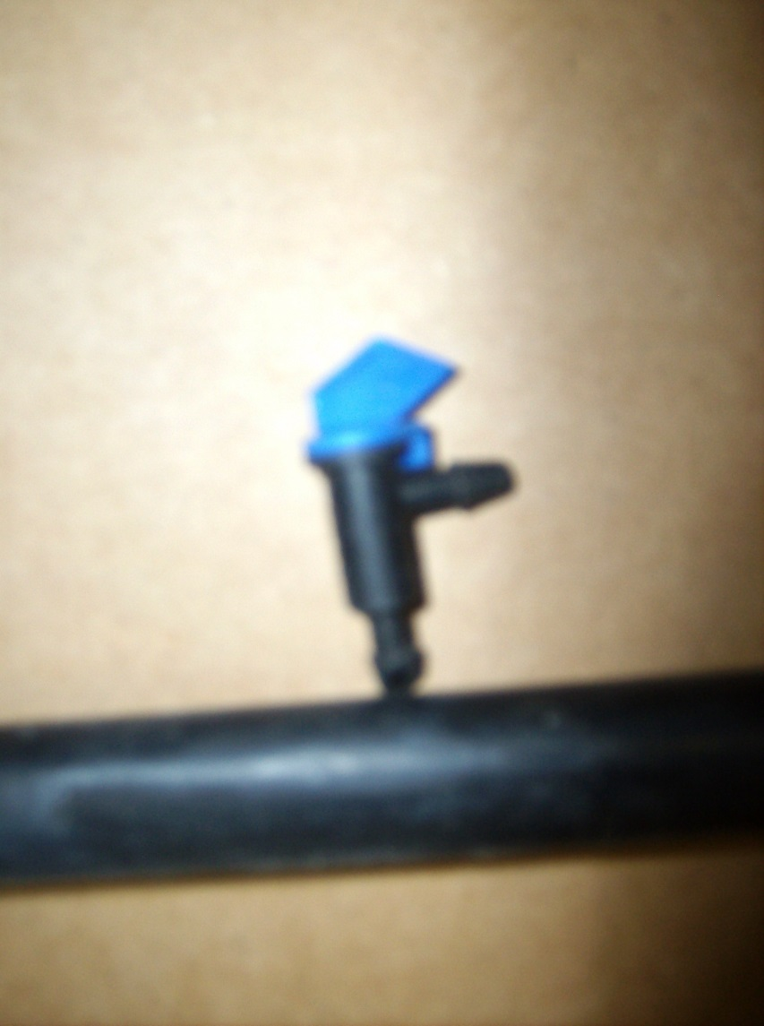
2 GALLON
PER HOUR
EMITTER

Slide 16
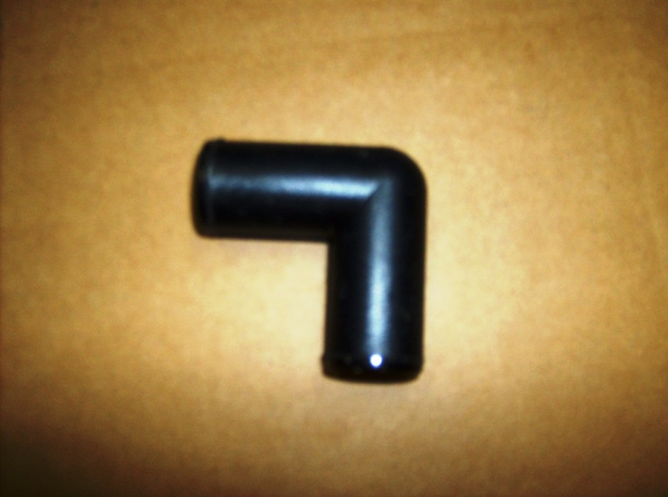
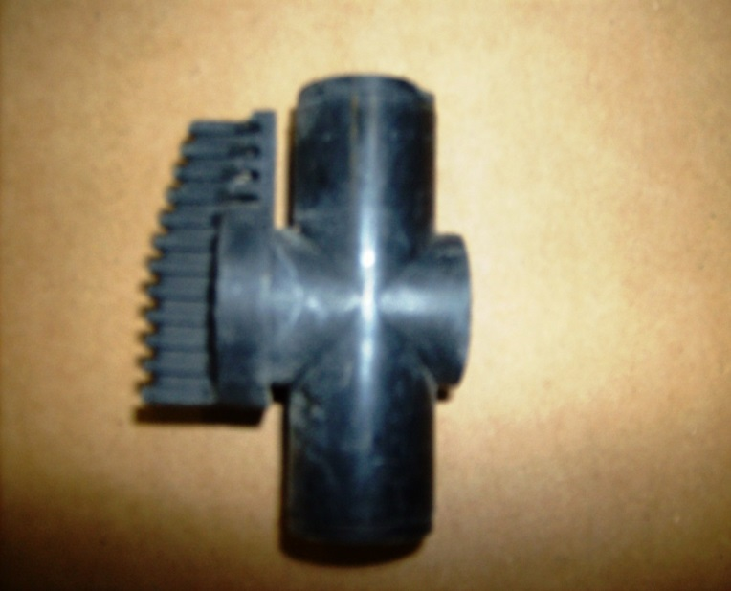
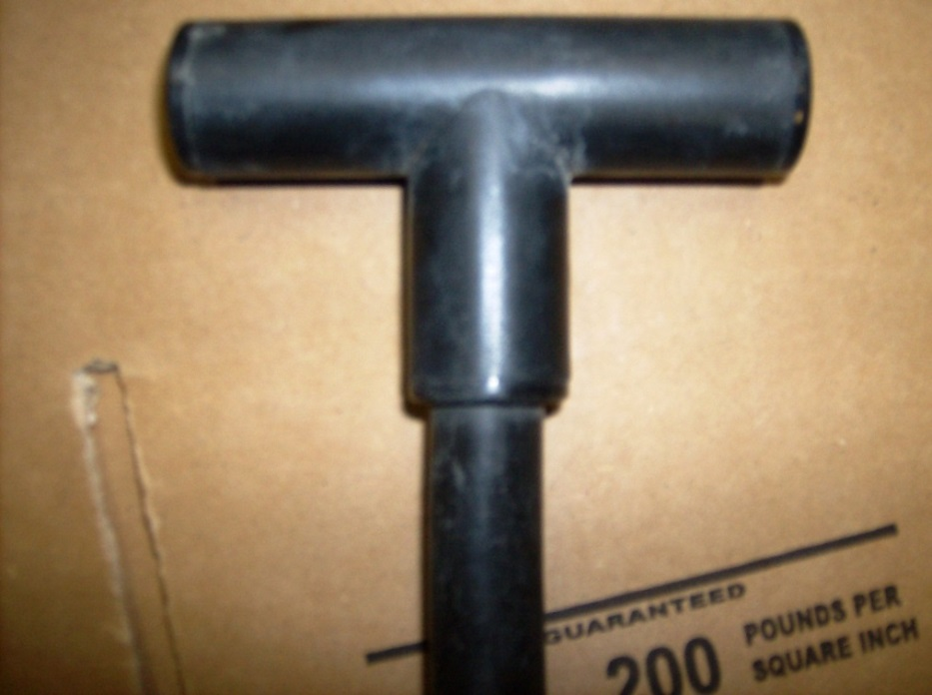
MAIN LINE ELBOW
MAIN LINE SHUT OFF VALVE
MAIN LINE TEE

Slide 17
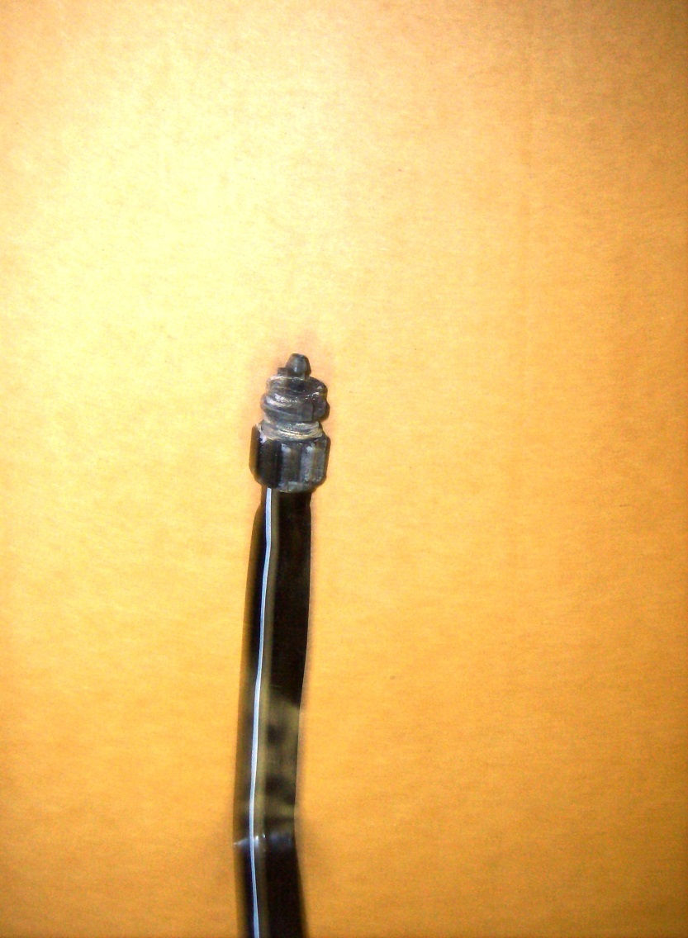
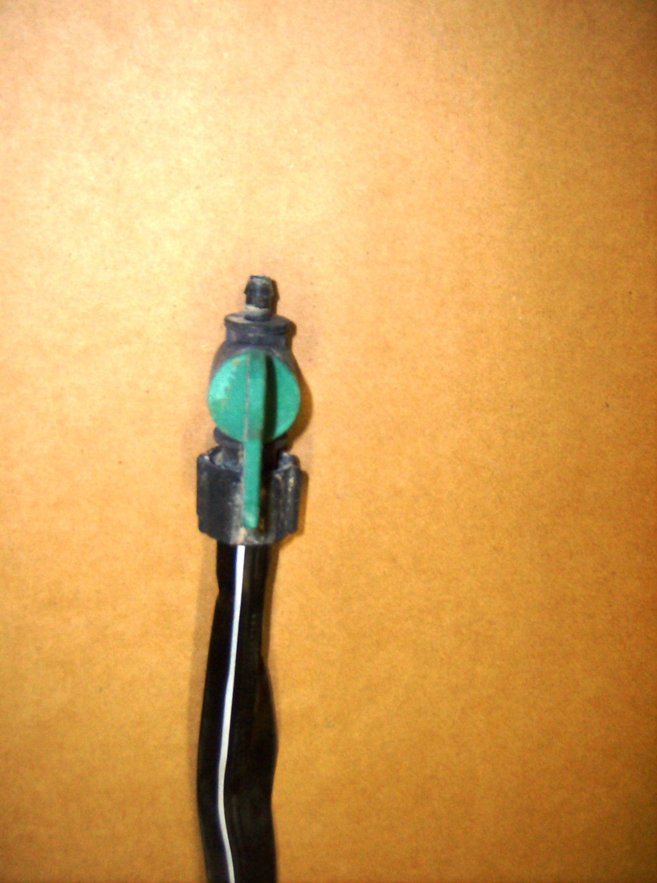
T-TAPE CONNECTOR
T-Tape Connector
With shut-off

Slide 18
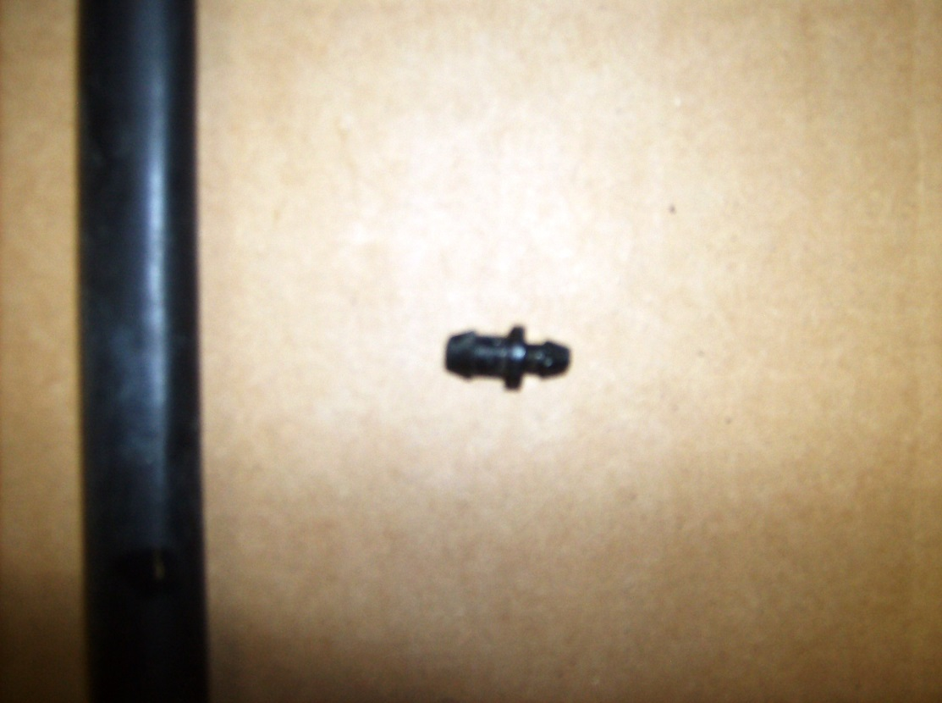
MOST IMPORTANT PART OF SYSTEM –
THE GOOF PLUG

Slide 19
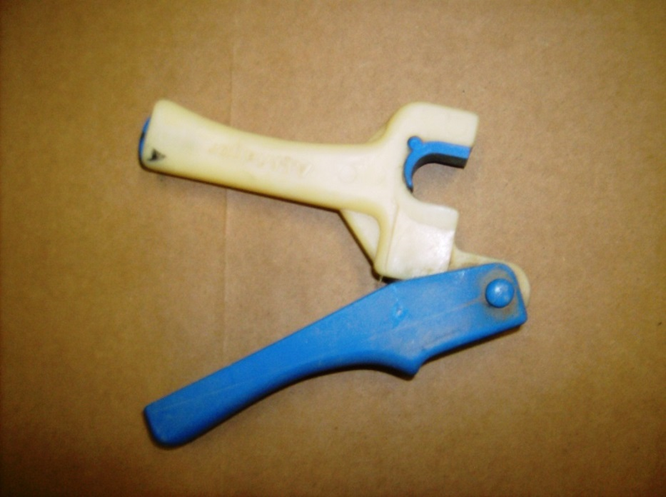
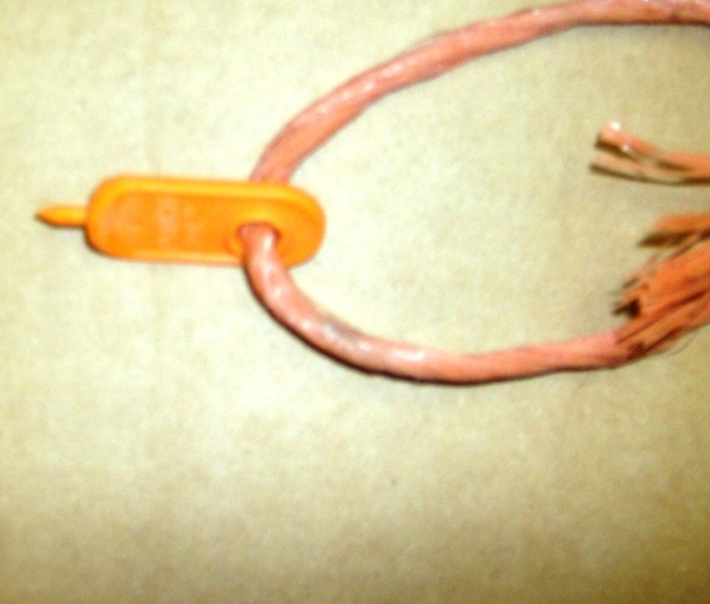
Punches for drip system installation

Slide 20
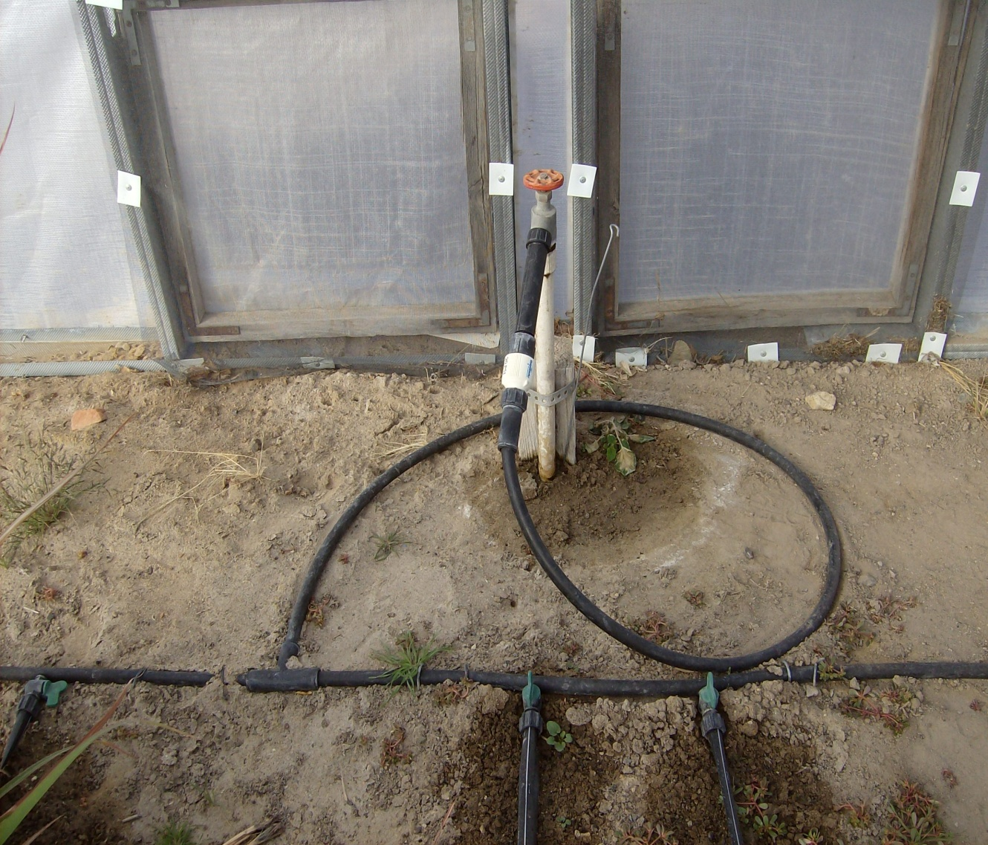
How it Works – Putting it all Together

Slide 21
Pick a system and stick with it
Commercial -- VS -- Home improvement store
All parts will vary in size
Commercial
.700” 0D
Dripworks Catalog or Internet:
www.dripworks.com/pro
Home improvement
.620” OD
Home Depot, Lowe’s
or hardware store
- VS -

Slide 22
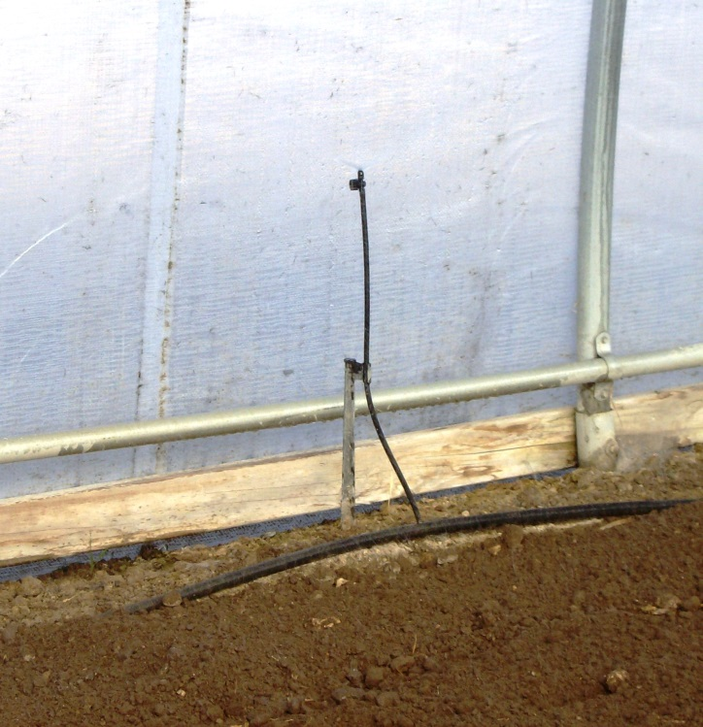
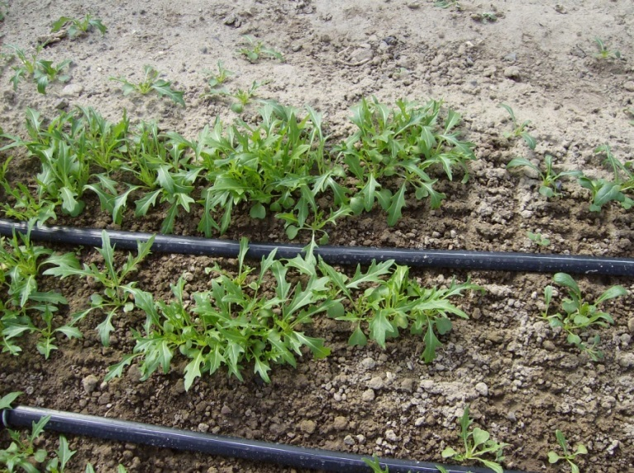
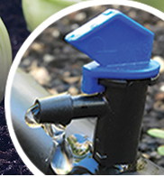
Sprayer
Choices in watering methods
T-Tape
Drip

Slide 23
WHEN TO WATER
Early Morning ??
Depending on Season:
Afternoon ??
Always avoid having wet foliage when the sun brings hot temps.
How much to water?
Most important -- be consistent.
You will soon learn what works best. Not enough or over-watering can both harm or cause problems.

Slide 24
PART 2 – SEASON EXTENSIONS
Can be used inside for additional heat, cooling, or frost protection SPRING -- SUMMER – FALL
Covering the soil in early cool months, to help warm the soil.
Agribon (aka Remay) or “fabric” covers placed over wire hoops, help warm soil, retain moisture, keep insects at bay, and will adds extra warmth to the crop.
Shade cloths placed over the hoop on the outside, helps cool entire structure. Inside; keeps crops cooler in warm spring, or hot summer months. (Hoop houses heat up quickly, and retain heat)

Slide 25
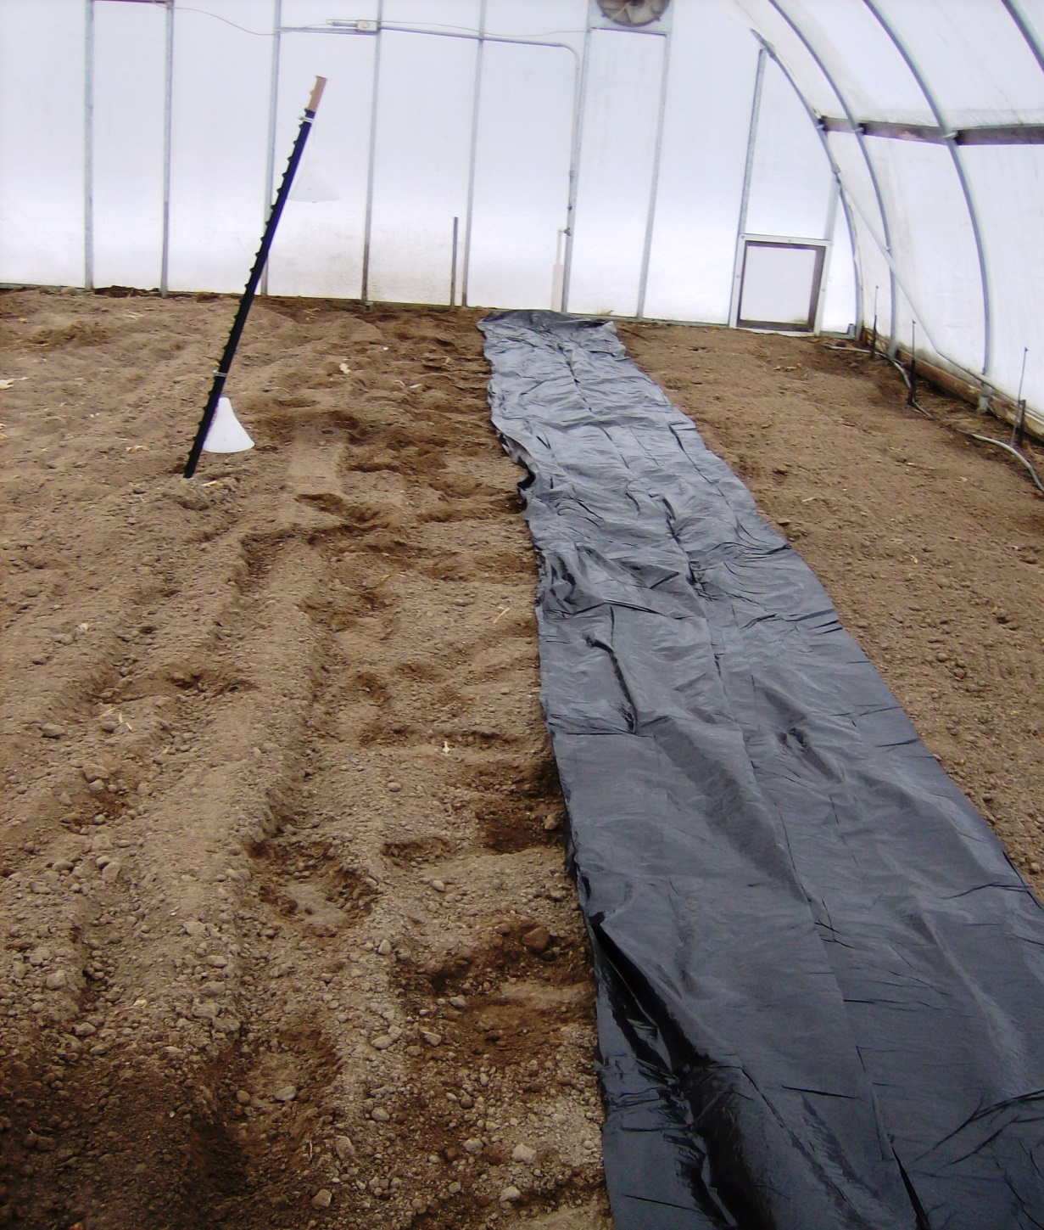
Methods to add weeks to your hoop house production.
Covering in early cool months, to help warm the soil.
Black Plastic pulls in heat, to help conserve soil moisture, inhibit weed growth. Stretched tightly over the soil surface, leads to earlier harvest and increased yields, good for heat-loving crops like peppers, and tomatoes.

Slide 26
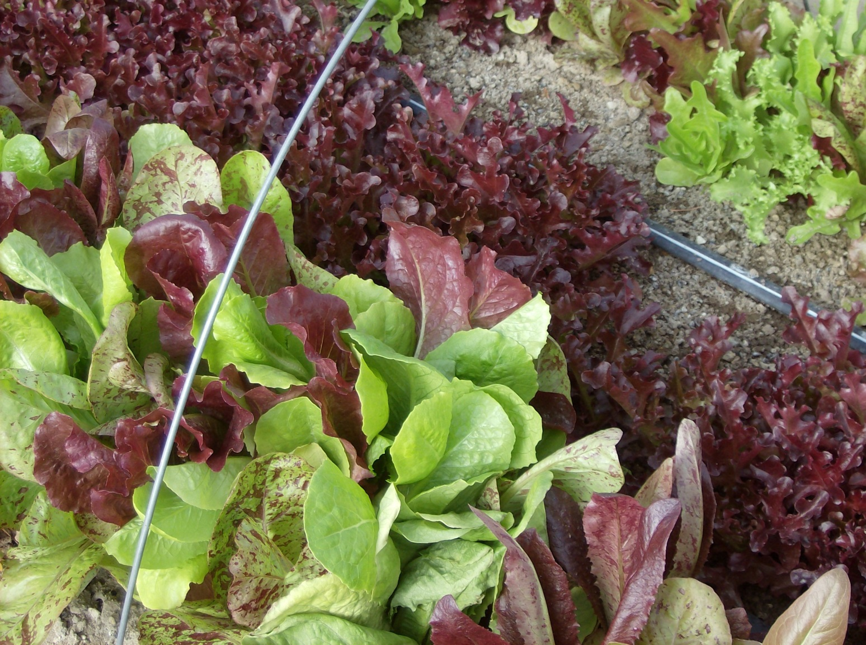
9 guage pre-cut wire hoops are best for holding fabrics or shade net inside or out.

Slide 27
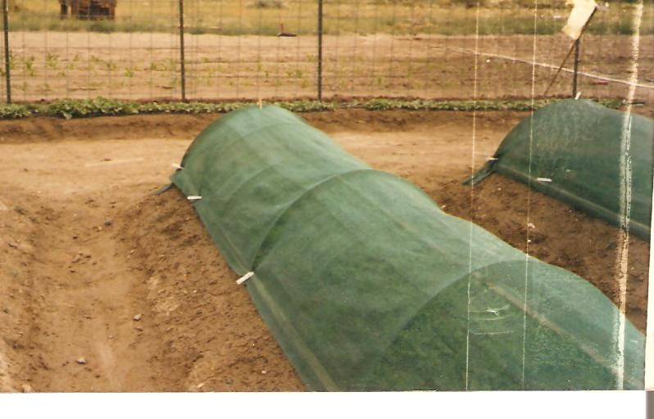
This type of shade fabric may be used inside hoophouse to help control excess heat.
Shade Netting over wire hoops

Slide 28
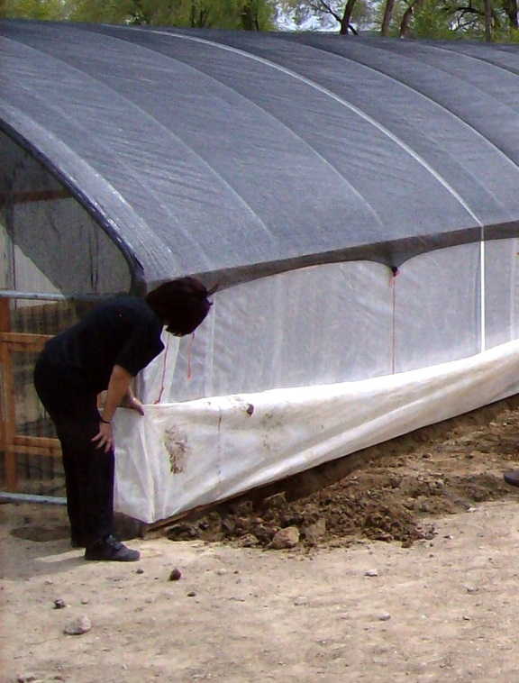
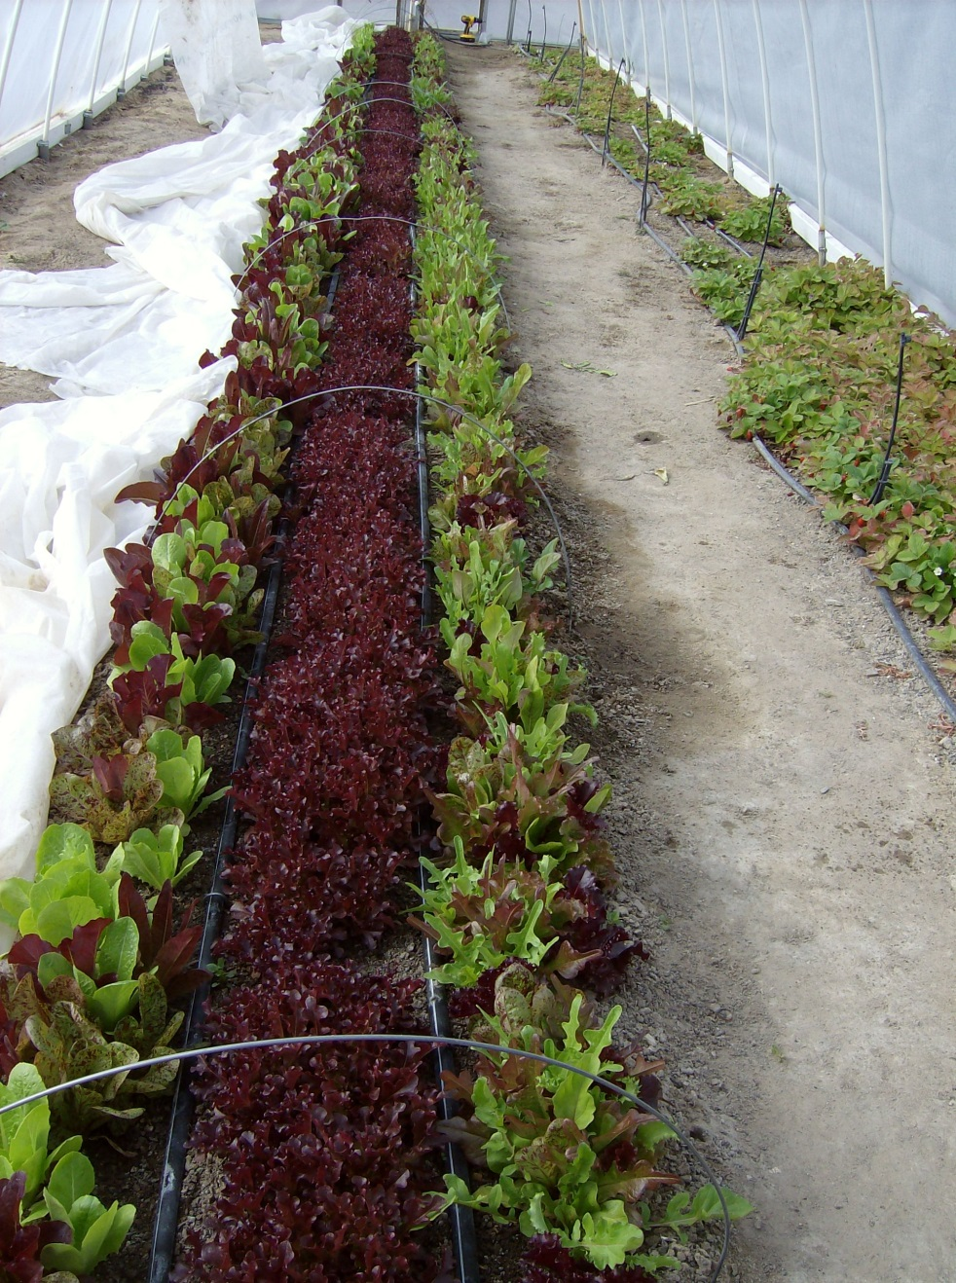
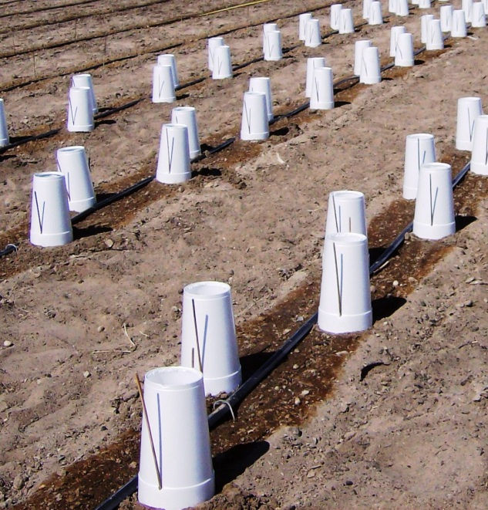
Wire hoops in place with frost fabric ready for freezing outside temps.
40% Shade netting installed on top cools entire hoophouse.
Protecting transplants is easy with styrofoam cups (various sizes), reuseable from year to year, for heat or cool temps.

Slide 29
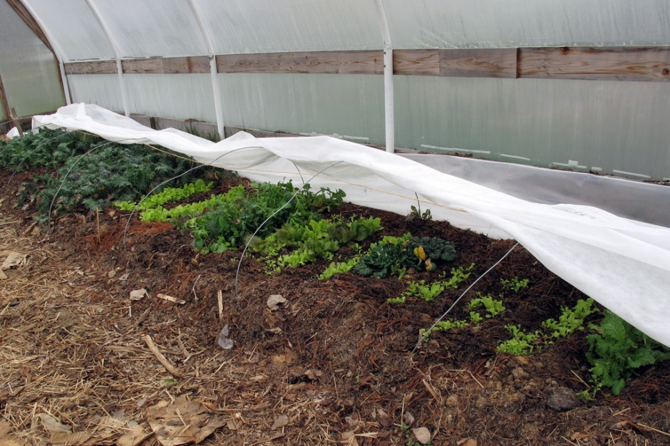
Agribon frost fabric ready to warm veggies on cool nights.

Slide 30
Always “Growing our future”
The seed you plant in a youngster’s mind
may one day grow into a farmer!

Slide 31
A FEW RESOURCES FOR DRIP SYSTEMS
To learn more or to purchase;
SHOP AROUND FOR YOUR BEST DEAL!
Try your local suppliers – here is just one:
Silverado Ranch Supply in Yerington
Bill Chounet: Mobile: 775-221-5599 or Store: 888-463-5599
Silverado is now a branch of Stanislaus Ranch Supply, CA,
Website is: www.srsupply.us
Check the Internet for other suppliers and
good ideas; here are just a few:
Dripworks – Quality Drip Irrigation Supplies – Willits CA
get your catalog at: www.DripWorks.com or 800-552-3747
Peaceful Valley Farm Supply –Grass Valley CA
More information: www.groworganic.com or 888-784-1722
A huge selection of how-to and videos to help you grow:
http://www.johnnyseeds.com/growers-library/growing-center.html

